Slide 1


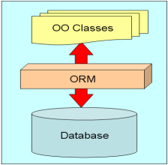


ORM Technologies and Entity Framework (EF)
ORM Concepts, Entity Framework, DbContext, CRUD Operations
SoftUni Team
Technical Trainers
Software University
http://softuni.bg

Slide 2

Table of Contents
ORM Technologies – Basic Concepts
Entity Framework - Overview
Reading Data with EF
CRUD operations using Entity Framework
Extending Entity Classes
Executing Native SQL Queries
Joining and Grouping Tables
Attaching and Detaching Objects

Slide 3
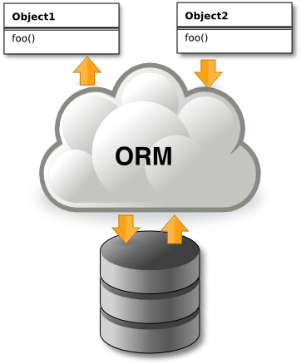
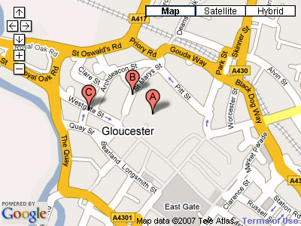


Introduction to ORM Technologies
What is Object-Relational Mapping (ORM)?

Slide 4
ORM Technologies
Object-Relational Mapping (ORM) is a programming technique for automatic mapping data and schema
Between relational database tables and object-oriented classes and objects
ORM creates a "virtual object database"
Can be used from within the programming language (C# or Java…)
ORM frameworks automate the ORM process
A.k.a. Object-Relational Persistence Frameworks

Slide 5
ORM Frameworks
ORM frameworks typically provide the following functionality:
Creating object model by database schema (DB first model)
Creating database schema by object model (code first model)
Querying data by object-oriented API (e.g. LINQ queries)
Data manipulation operations
CRUD – create, retrieve, update, delete
ORM frameworks automatically generate SQL to perform the requested data operations

Slide 6
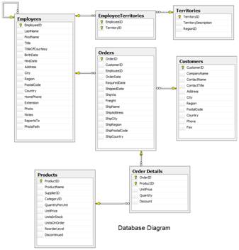
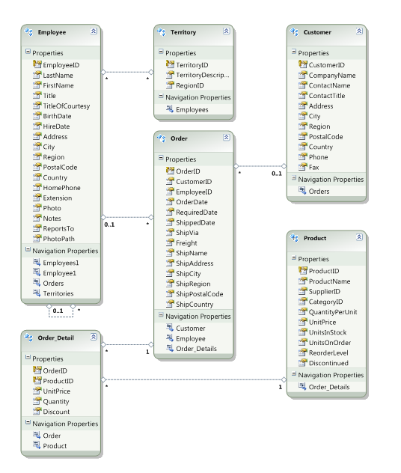




ORM Mapping – Example
Database and entity mapping diagrams for a subset of the Northwind database
Relational database schema
ORM Entities
(C# classes)
ORM
Framework

Slide 7
ORM Advantages and Disadvantages
Object-relational mapping (ORM) advantages
Developer productivity: writing less code
Abstract from differences between object and relational world
Complexity hidden within the ORM
Manageability of the CRUD operations for complex relationships
Easier maintainability
Disadvantages:
Reduced performance (due to overhead or incorrect ORM use)
Reduces flexibility (some operations are hard for implementing)

Slide 8
ORM Frameworks in .NET
Built-in ORM tools in .NET Framework and VS
Entity Framework (LINQ-to-Entities)
LINQ-to-SQL (old fashioned, not used)
Both combine entity class mappings and code generation, SQL is generated at runtime
Third party ORM tools
NHibernate – the old daddy of ORM
Telerik OpenAccess ORM

Slide 9
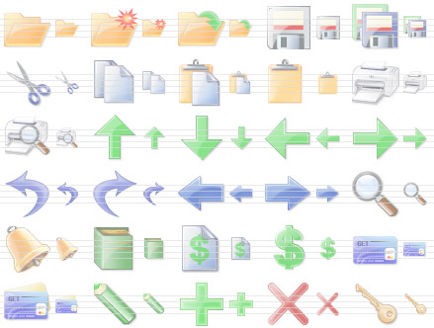
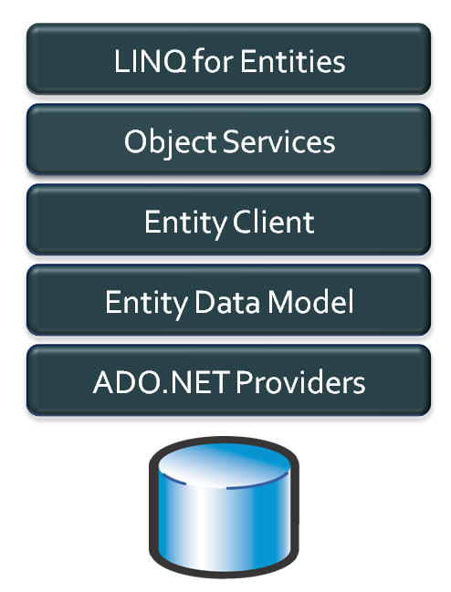


Entity Framework (EF)
Object-Relation Persistence Framework for .NET

Slide 10
Overview of EF
Entity Framework (EF) is the standard ORM framework for .NET
Provides a run-time infrastructure for managing SQL-based database data as .NET objects
The relational database schema is mapped to an object model
Visual Studio provides built-in tools for generating Entity Framework data models
Data mappings consist of C# classes, XML and attributes
EF provides a powerful data manipulation API
CRUD operations and complex querying with LINQ

Slide 11
Entity Framework Features
Maps tables, views, stored procedures and functions as .NET objects
Provides LINQ-based data queries
Executed as SQL SELECTs on the database server
Parameterized queries
Built-in CRUD operations – Create / Read / Update / Delete
Creating / deleting / upgrading the database schema
Tracks changes to in-memory objects

Slide 12
Entity Framework Features (2)
Works with any relational database
You need an Entity Framework data provider
Work with a visual model, database or with your own classes
Has very good default behavior
Very flexible for more granular control
Open source – independent release cycle
entityframework.codeplex.com
github.com/aspnet/EntityFramework

Slide 13
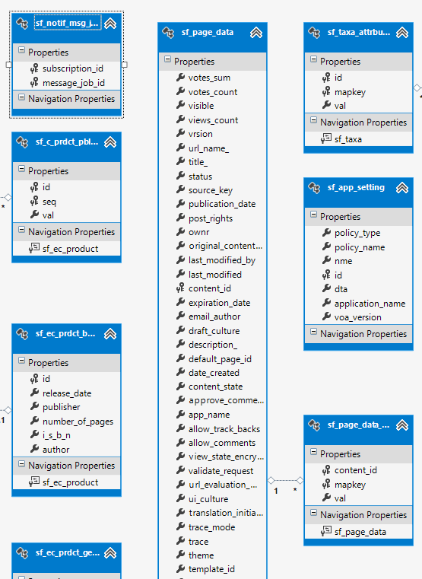
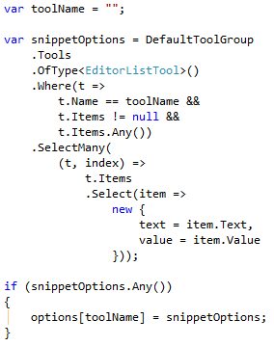
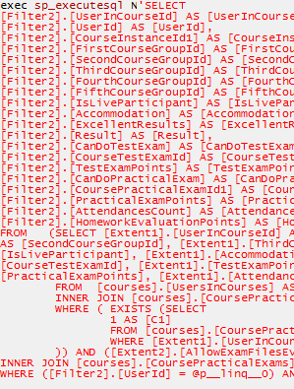
EF: Basic Workflow
Define the data model (use a DB Visual designer or code first)
Write & execute query over IQueryable
EF generates & executes an SQL query in the DB

Slide 14
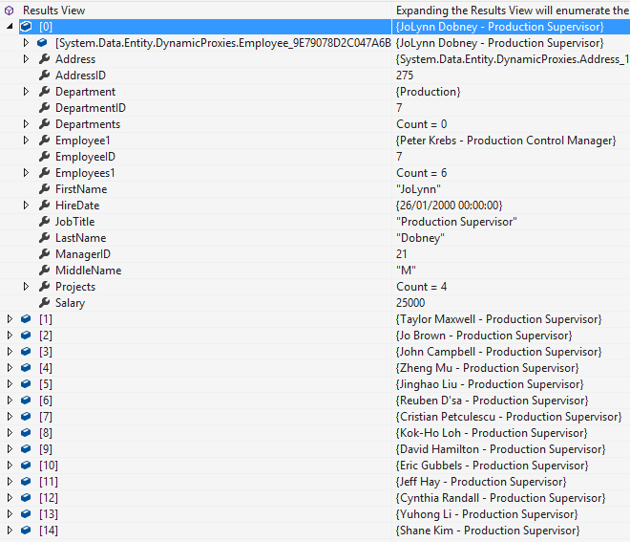
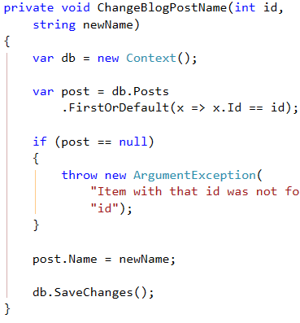
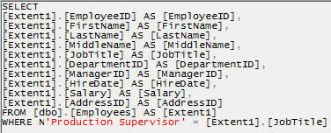
EF: Basic Workflow (2)
EF transforms the query results into .NET objects
Modify data with C# code and call "Save Changes"
Entity Framework generates & executes SQL command to modify the DB

Slide 15
EF Components
The DbContext class
DbContext holds the database connection and the entity classes
Provides LINQ-based data access
Implements identity tracking, change tracking, and API for CRUD operations
Entity classes
Hold entities (objects with their attributes and relations)
Each database table is typically mapped to a single C# entity class

Slide 16
EF Components (2)
Associations (relationship mappings)
An association is a primary key / foreign key-based relationship between two entity classes
Allows navigation from one entity to another
Concurrency control
Entity Framework uses optimistic concurrency control
No locking by default
Automatic concurrency conflict detection
var courses = student.Courses.Where(…);

Slide 17
EF Runtime Metadata
Conceptual Model Schema
Mappings
DB
Database Structure Schema

Slide 18

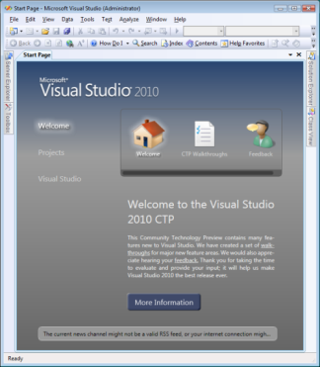

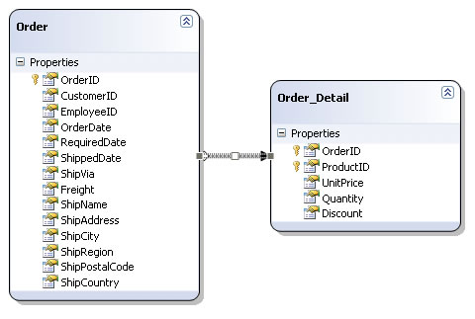
The Entity Framework Designer in Visual Studio
Live Demo

Slide 19


Reading Data with Entity Framework

Slide 20
The DbContext Class
The DbContext class is generated by the Visual Studio designer
DbContext provides:
Methods for accessing entities (object sets)
Methods for creating new entities (Add() methods)
Ability to manipulate database data though entity classes
Read, modify, delete, insert
Easily navigate through the table relationships
Executing LINQ queries as native SQL queries
Create the DB schema in the database server

Slide 21
Using DbContext Class
First create instance of the DbContext:
In the constructor you can pass a database connection string and mapping source
DbContext properties:
Connection – the SqlConnection to be used
CommandTimeout – SQL commands execution timeout in the DB
All entity classes (tables) are listed as properties
e.g. IDbSet<Employee> Employees { get; }
var softUniEntities = new SoftUniEntities();

Slide 22
Reading Data with LINQ Query
Executing LINQ-to-Entities query over EF entity:
Employees property in the DbContext:
using (var context = new SoftUniEntities())
{ var employees =
from e in context.Employees
where e.JobTitle == "Design Engineer"
select e; }
This will be translated to an SQL query by EF
public partial class SoftUniEntities : DbContext
{
public ObjectSet<Employee> Employees { get; set; }
public IDbSet<Project> Projects { get; set; }
public IDbSet<Department> Departments { get; set; }
}

Slide 23
Reading Data with LINQ Query
We can also use extension methods for constructing the query
Find element by id
using (var context = new SoftUniEntities())
{
var employees = context.Employees
.Select(c => c.FirstName)
.Where(c => c.JobTitle == "Design Engineering")
.ToList();
}
This is called projection
ToList() method executes the query
using (var context = new SoftUniEntities())
{
var project = context.Projects.Find(2);
Console.WriteLine(project.Name);
}

Slide 24
Logging the Native SQL Queries
Printing the native database SQL command behind a query:
This will print the SQL native query executed at the database server to select all Employees
Can be printed to file using StreamWriter class instead of Console class
var query = context.Employees;
Console.WriteLine(query.ToString());

Slide 25



Retrieving Data with EF
Live Demo

Slide 26



Create, Update and Delete Data in Entity Framework

Slide 27
Creating New Data
To create a new database row use the method Add(…) of the corresponding collection:
SaveChanges() method executes the SQL insert / update / delete commands in the database
var project = new Project()
{
Name = "Judge System",
StartDate = new DateTime(2015, 4, 15),
};
context.Orders.Add(order);
context.SaveChanges();
Create a new project object
Mark the object for inserting
This will execute an SQL INSERT

Slide 28
Cascading Inserts
We can also add cascading entities to the database:
This way we don't have to add Project individually
They will be added when the Employee entity (employee) is inserted to the database
Employee employee = new Employee();
employee.FirstName = "Petya";
employee.LastName = "Grozdarska";
employee.Projects.Add(new Project { Name = "SoftUni Conf"} );
softUniEntities.Employees.Add(employee);
softUniEntities.SaveChanges();

Slide 29
Updating Existing Data
DbContext allows modifying entity properties and persisting them in the database
Just load an entity, modify it and call SaveChanges()
The DbContext automatically tracks all changes made on its entity objects
Employees employee =
softUniEntities.Employees.First();
employees.FirstName = "Alex";
context.SaveChanges();
This will execute an SQL SELECT to load the first order
This will execute an SQL UPDATE

Slide 30
Deleting Existing Data
Delete is done by Remove() on the specified entity collection
SaveChanges() method performs the delete action in the database
Mark the entity for deleting at the next save
Employees employee =
softUniEntities.Employees.First();
softUniEntities.Employees.Remove(employee);
softUniEntities.SaveChanges();
This will execute the SQL DELETE command

Slide 31
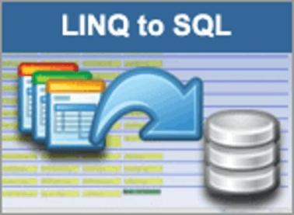



CRUD Operations with EF
Live Demo

Slide 32
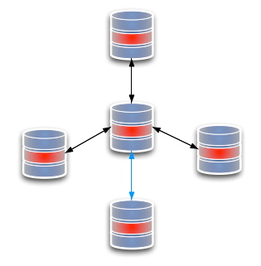
Extending Entity Classes
Add Methods like ToString(), Equals(), etc…

Slide 33
Extending Entity Classes
When using "database first" or "model first" entity classes are separate .cs files, generated by T4 template XXXModel.tt
Each time we update the EntitiesModel from the database all files are generated anew
If we add methods like ToString(), they will be lost
Entity classes are "partial" → extend them in another file
When using "code first" this is not a problem

Slide 34

Extending EF Entity Classes
Live Demo

Slide 35

Executing Native SQL Queries
Native SQL
Parameterless and Parameterized

Slide 36
Executing Native SQL Queries
Executing a native SQL query in Entity Framework directly in its database store:
Example:
Examples are shown in SQL Server but the same can be done for any other database
ctx.Database.SqlQuery<return-type>(native-SQL-query);
string query = "SELECT count(*) FROM dbo.Employees";
var queryResult = ctx.Database.SqlQuery<int>(query);
int customersCount = queryResult.FirstOrDefault();

Slide 37
Native SQL Queries with Parameters
Native SQL queries can also be parameterized:
var context = new SoftUniEntities();
string nativeSQLQuery =
"SELECT FirstName + ' ' + LastName " +
"FROM dbo.Employees WHERE JobTitle = {0}";
var employees = context.Database.SqlQuery<string>(
nativeSQLQuery, "Marketing Specialist");
foreach (var emp in employees)
{
Console.WriteLine(emp);
}
Parameter placeholder
Parameter value

Slide 38
Executing Native SQL Queries
Native SQL
Live Demo

Slide 39
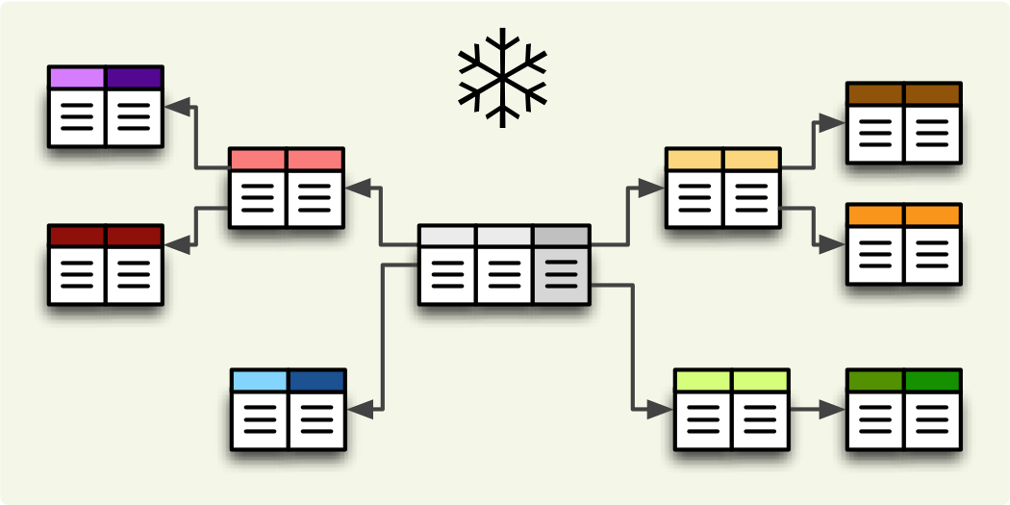
Joining and Grouping Tables
Join and Group Data Using LINQ

Slide 40
Joining Tables in EF
Join tables in EF with LINQ / extension methods on IEnumerable<T> (like when joining collections)
var employees =
from employee
in softUniEntities.Employees
join department
in softUniEntities.Departments
on employee.EmployeeID
equals department.DepartmentID
select new {
Employee = employee.FirstName,
JobTitle = employee.JobTitle,
Department = department.Name
};
var employees =
softUniEntities.Employees.Join(
softUniEntities.Departments,
(e => e.DepartmentID),
(d => d.DepartmentID),
(e, d) => new {
Employee = e.FirstName,
JobTitle = e.JobTitle,
Department = d.Name
}
);

Slide 41
Grouping Tables in EF
Grouping also can be done by LINQ
The same ways as with collections in LINQ
Grouping with LINQ:
Grouping with extension methods:
var groupedEmployees =
from employee in softUniEntities.Employees
group employee by employee.JobTitle;
var groupedCustomers = softUniEntities.Employees
.GroupBy(employee => employee.JobTitle);

Slide 42


Joining and Grouping Tables
Live Demo

Slide 43


Attaching and Detaching Objects in EF

Slide 44
Attaching and Detaching Objects
In Entity Framework, objects can be:
Attached to the object context (tracked object)
Detached from an object context (untracked object)
Attached objects are tracked and managed by the DbContext
SaveChanges() persists all changes in DB
Detached objects are not referenced by the DbContext
Behave like a normal objects, which are not related to EF

Slide 45
Attaching Detached Objects
When a query is executed inside an DbContext, the returned objects are automatically attached to it
When a context is destroyed, all objects in it are automatically detached
E.g. in Web applications between the requests
You might later on attach to a new context objects that have been previously detached

Slide 46
Detaching Objects
When an object is detached?
When we get the object from a DbContext and then Dispose it
Manually: by set the EntryState to Detached
Employee GetEmployeeById(int id)
{
using (var softUniEntities = new SoftUniEntities())
{
return softUniEntities.Employees
.First(p => p.EmployeeID == id);
}
}
Now the returned product is detached

Slide 47
Attaching Objects
When we want to update a detached object we need to reattach it and then update it: change to Attached state
void UpdateName(Employee employee, string newName)
{
using (var softUniEntities = new SoftUniEntities())
{
var entry = softUniEntities.Entry(employee);
entry.State = EntityState.Added;
employee.FirstName = newName;
softUniEntities.SaveChanges();
}
}

Slide 48



Attaching and Detaching Objects
Live Demo

Slide 49







ORM Technologies and Entity Framework (EF)
https://softuni.bg/courses/database-applications

Slide 50
License
This course (slides, examples, demos, videos, homework, etc.) is licensed under the "Creative Commons Attribution-NonCommercial-ShareAlike 4.0 International" license
Attribution: this work may contain portions from
"Databases" course by Telerik Academy under CC-BY-NC-SA license

Slide 51





Free Trainings @ Software University
Software University Foundation – softuni.org
Software University – High-Quality Education, Profession and Job for Software Developers
softuni.bg
Software University @ Facebook
facebook.com/SoftwareUniversity
Software University @ YouTube
youtube.com/SoftwareUniversity
Software University Forums – forum.softuni.bg

